Slide 1
Module 5:
Using open source data via api
Data Use for Decision Science Training

Slide 2
Learning objectives
Understand the basic concepts of API
  Retrieve and use open-source data for your data use projects with R

Slide 3

Epidemic Intelligence for Collaborative Surveillance
Identify the needs
Identify the data
Run (automated) analyses using the data
Develop analytical plans
Develop a sustainable data flow/pipeline
Generate a routine information product
Communicate with decision-makers
 | Module | Topic
 | 1 | Epidemic Intelligence for Collaborative Surveillance
 | 2 | Data use to support decision making with R
 | 3 | Effective data translation & communication
 | 4 | Effective data management practice
 | 5 | Open-source data use
 | 6 | Epi analysis & manuscript writing

Slide 4
What is open-source data
Any data that is freely available and accompanied by an open license that allows for its redistribution, modification, and integration into other systems.
Open-source data are
    Machine-Readable (e.g., .csv, .json, .tif rather than a PDF).
    Non-Proprietary
    Structured

Slide 5

Public health implications
Open-source data act as the "contextual layers."
While your primary surveillance, response, or program data tells you what is happening, the open-source data (climate, mobility, population) can tell you more about why.

Slide 6
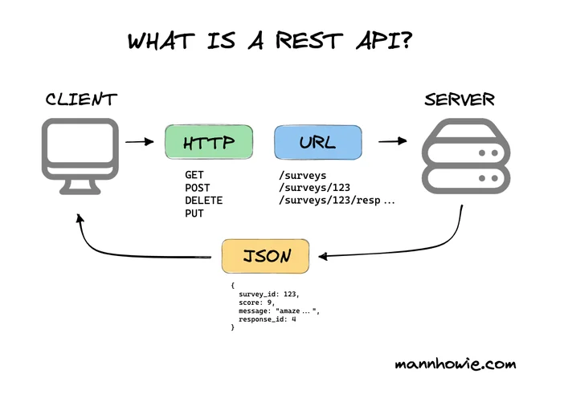
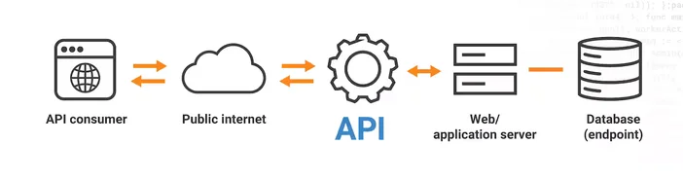
What is API
Application Programming Interface
a set of rules and protocols that allows different software applications to communicate, exchange data, and use each other's features
Think of it as a food delivery app
REST API - most common web style today. Resource‑based, uses HTTP methods (GET/POST/PUT/DELETE), typically returns JSON.
Notes:
Think of it as a menu: your app can “order” data or actions, and the API tells the kitchen (a service) exactly what to cook and how it’ll be served back.

Slide 7
Why API (vs. downloading)
Automation: Your data updates automatically when the source data changes. No more "Final_Data_v2_Edited.csv"
Access high-resolution data (e.g., population at 100m grid level) without crashing your computer.

Slide 8
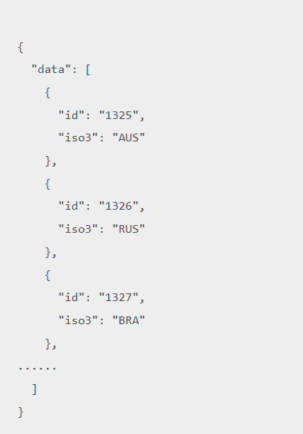
What is JSON
JavaScript Object Notation
A nested tree structure (folders within folder)
Key: variable name
Value: data

Slide 9
Important: the gatekeepers
APIs aren't infinite. Servers will "throttle" or block you if you make too many requests per minute.
Open source doesn’t mean “do whatever you want” (Some data like GBD allows personal research but requires permission for commercial use or redistribution.)
To query the right data, you usually have to find the right keys and IDs in a separate metadata table first.
Some professional APIs (GBD, Google, Twitter) require an API Key or Token (When using tokens, don’t recommended to hard-code your key into a script you share!)

Slide 10
Some useful open-source data for epidemic intelligence
(and how to extract & use them for decision-making)

Slide 11
Some Useful open-source data for public health decision-makers
WorldPoP - Open spatial demographic datasets (age/sex structures) and other contextual data
GRID3 - Geo-Referenced Infrastructure and Demographic Data
NASA satellite images for environmental variables (surface temperature, humidity, rainfall, vegetation index, etc)
OpenStreetMap for road and urban infrastructure

Slide 12
worldpop
A research initiative providing open-access, spatially explicit datasets on population distribution, demographics, and dynamics.
Combines census, survey, and satellite data using advanced statistical modeling to map population at 100m x 100m resolution.
Key data available (in geotiff format):
  Population counts
  Age/Sex breakdowns by 5-year age groups.
  Models of population movement.
  Births and pregnancies

Slide 13
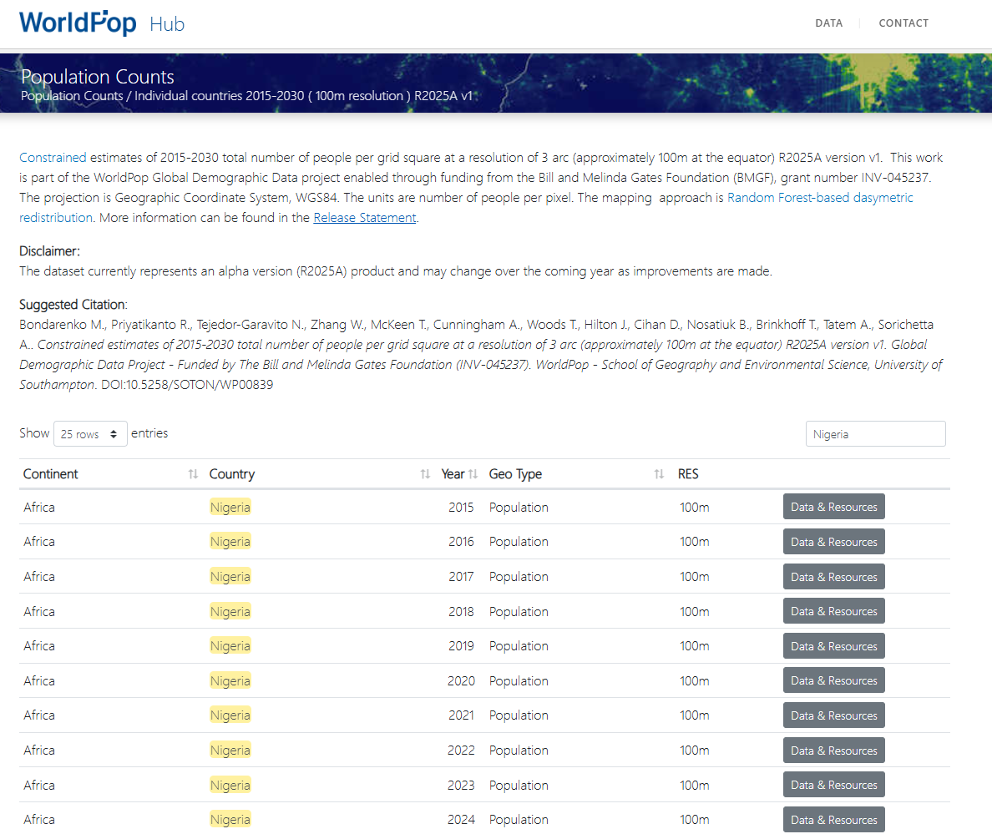
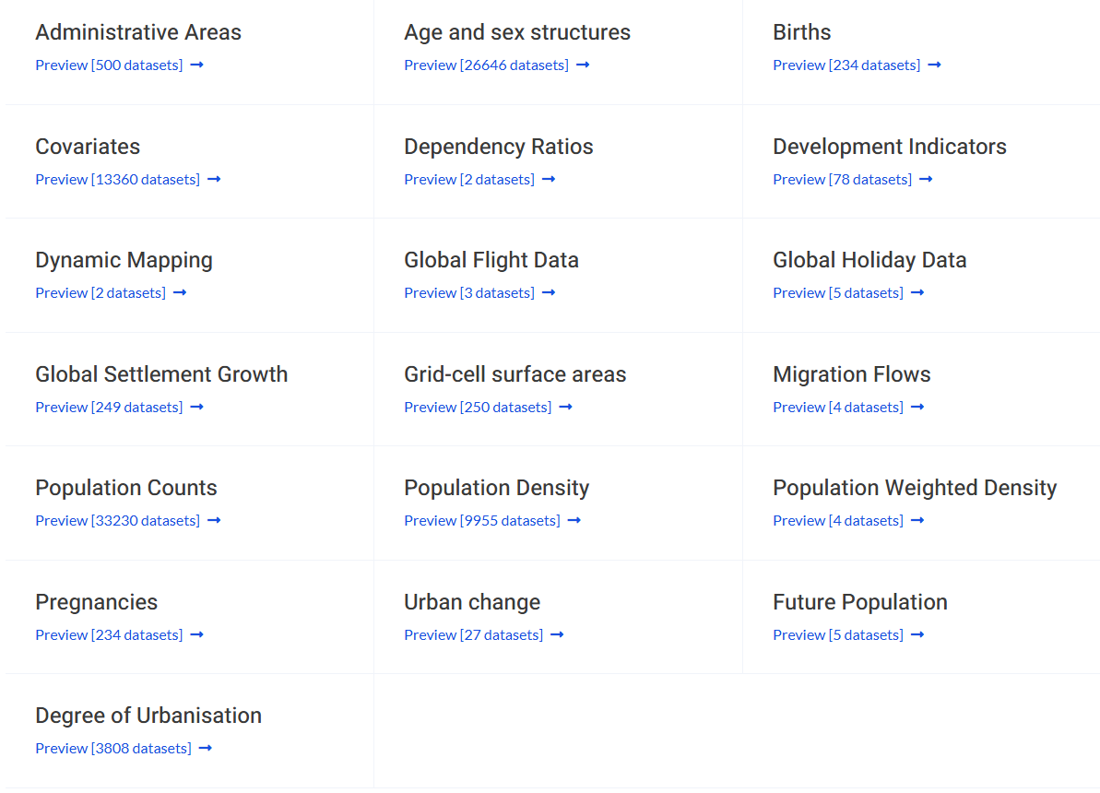
WorldPop data catalog

Slide 14
Note on worldpop API
I honestly prefer downloading geotiff directly from Worldpop website: This approach is more than suitable when the data is not dynamic (meaning it only gets updated once every year or more).
Info on API queries: https://www.worldpop.org/sdi/introapi/
For GRID3 countries, you can also use GRID3 API to source the data.

Slide 15
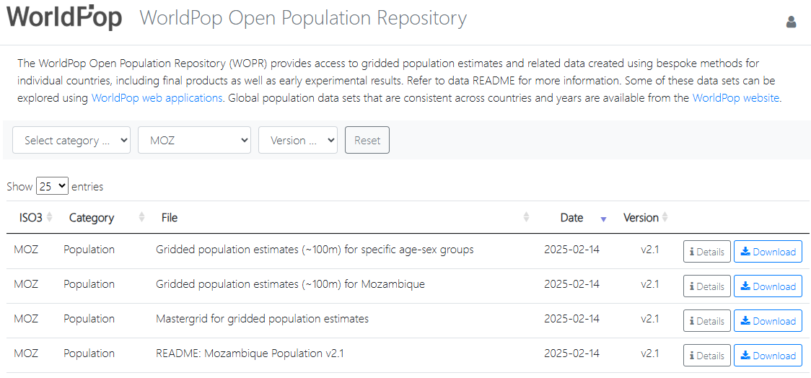
Worldpop Open Population Repository
Provides high-resolution gridded population-related estimates co-produced by governments and UN agencies.
Available data differs country by country

Slide 16
Use case 1
Planning a measles campaign in a region with outdated census data
Use WorldPop 100m*100m population count data to identify the precise number and location of children under 5 years old by district or facility catchment area level.
Supports micro-planning for vaccine procurement, cold chain logistics, and efficient deployment of health worker teams.

Slide 17
GRID3 (Geo-Referenced Infrastructure and Demographic Data for Development)
A global partnership (including UNFPA and WorldPop) that facilitates the collection and use of high-quality geospatial data.
Integrates and manages authoritative data on boundaries, human settlements, and key infrastructure to support decision-making.
Key available data (in GeoJSON format)
  Points of interest data
  Population data
  Settlement data
  Health facility data (operational wards)
  Roads data, etc

Slide 18
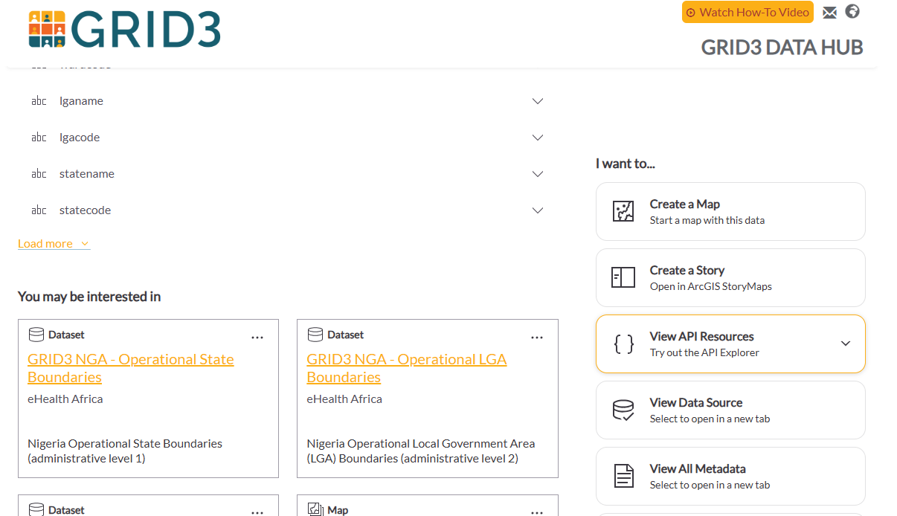
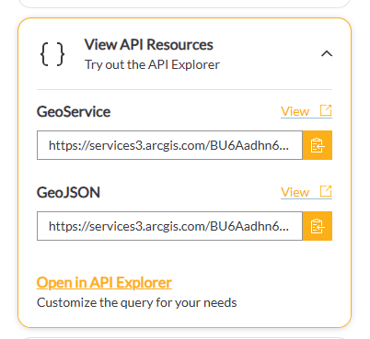
GRID3

Slide 19
Use case 2
Rapidly deploying resources during a cholera surge in IDP settlement areas.
Use GRID3 Settlement Extents data to quickly identify unmapped operational villages.
Combine this with GRID3 points-of-interest data to locate the nearest water points and health centers.
Creates operational map for targeting hygiene kit distribution and establishing oral rehydration points.

Slide 20
google earth engine
A cloud platform for petabyte-scale analysis of satellite imagery and other geospatial datasets.
Provides parallel processing power to analyze over 40 years of Earth observation data (Landsat, Sentinel) using a standard coding interface (JavaScript/Python/R)
Data catalogue provides a “menu” of data we can choose from (https://developers.google.com/earth-engine/datasets/)
You send the code to the data (vs. downloading data to your code): We can use GEE’s code editor (https://code.earthengine.google.com/, supports JAVA or python) or R (rgee package) to ask the cloud for a summary of data we want (or python)

Slide 21
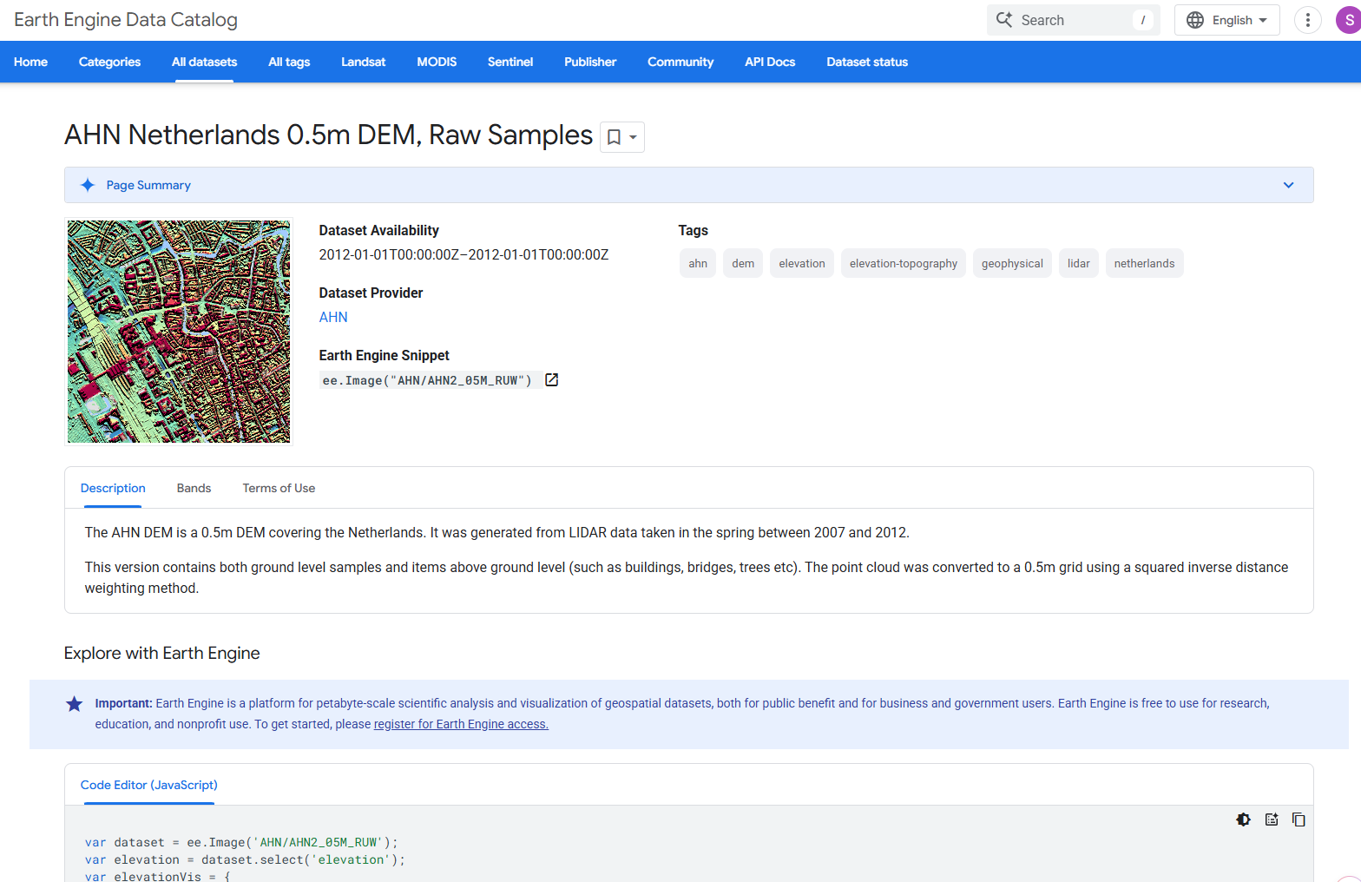
GEE data catalog
Image vs. Image Collection
Data dictionary (“Bands”)
Example code for extraction (currently only supported in JavaScript)

Slide 22
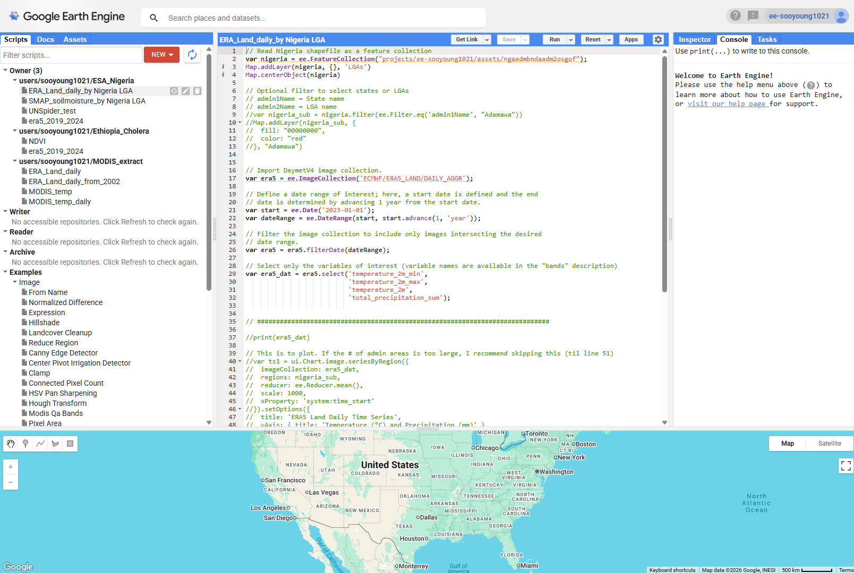
GEE code editor
Write scripts to extract data
Upload shaepfiles to “Assets” tab

Slide 23
Use case 3
Predicting where and when malaria cases will spike based on changing weather patterns.
Analyze GEE’s time-series data for land surface temperature, precipitation, and vegetation (NDVI).
Correlate this data with historical case counts using modeling techniques (i.e., DLNM)
Create dynamic malaria risk maps to pre-position rapid diagnostic tests and insecticide-treated nets weeks before a projected peak.

Slide 24
Open street map
A collaborative project to create a free, editable map of the world, built by a community of mappers who contribute and maintain data (often enriched by local “mapathons”)
An open-source, crowdsourced database of spatial "primitive" data: points (nodes), lines (ways), and polygons (relations) representing the physical world. → usually layered with other maps (e.g., tmap) for visualization.
The data is free to use for any purpose under an Open Database License (ODbL).
Maps everything from major highways to footpaths, building footprints, and local landmarks.

Slide 25
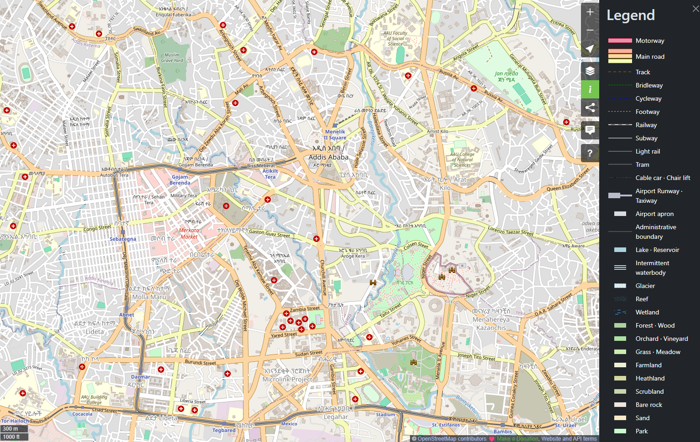

Slide 26
Use case 4
Determining which populations are truly within "reach" of emergency obstetric care.
Linear distance (Euclidean) methods often ignores geographic realities.
Use OSM road networks to calculate 30-minute travel-time isochrones (isochrones) around health facilities, accounting for road types and surface conditions.
Identify "service deserts" where communities are geographically close to a clinic but functionally cut off due to poor road connectivity or natural barriers.

Slide 27
More Data Use cases
Public Health Intelligence Layering Challenge!

Slide 28
Scenario
A neighboring district has just reported a confirmed outbreak of Yellow Fever. Your task is to design a targeted vector control and vaccination program for a high-risk, semi-rural border zone in your district.
You have 48 hours to present a data-driven deployment plan to the National Yellow Fever Incident Management Team.

Slide 29
available data
Data Source | Description
Outbreak line list | A list of suspected and confirmed cases with their epidemiological information, case narrative, and household geocode.
WorldPop | A 100m gridded raster of population counts, including a breakdown of children under 5 and adults over 65.
GRID3 | A validated layer of "Settlement Extents" (building clusters) and a master list of 15 Health Facility points with "Type" (Clinic vs. Hospital).
Google Earth Engine | A time-series of NDVI (Vegetation Greenness) and daily precipitation for the last 30 days.
OpenStreetMap | A vector layer of all "primary," "secondary," and "unclassified" (dirt/path) roads in the district.

Slide 30
Data-driven decision-making
Data Source | Description
Outbreak line list | A list of suspected and confirmed cases with their epidemiological information, case narrative, and household geocode.
WorldPop | A 100m gridded raster of population counts, including a breakdown of children under 5 and adults over 65.
GRID3 | A validated layer of "Settlement Extents" (building clusters) A master list of 15 Health Facility points with "Type" (Clinic vs. Hospital). A list of IDP sites in the district and the neighboring district.
Google Earth Engine | A time-series of NDVI (Vegetation Greenness) and daily precipitation for the last 30 days.
OpenStreetMap | A vector layer of all "primary," "secondary," and "unclassified" (dirt/path) roads in the district.
How will you determine which 3 of the 15 health facilities should be designated as "Yellow Fever Vaccination Hubs”?
Without any entomological survey data, how will you identify where the mosquitoes are most likely to breed right now?
What other decisions can you support based on available data?

Slide 31
Useful resources
Github repo with shapefiles and example codes.
Other sources of open source data
GBD
FEWSNET

